Slide 1
Mongo DB
A Comprehensive Overview and Hands-On Implementation

Slide 2
What is MongoDB
A NoSQL database program using JSON-like documents with optional schemas.
Core Characteristics:
Document-oriented, meaning data is stored in documents rather than rows and tables.
Schema-less or schema-flexible, allowing for dynamic and evolving data structures.
High scalability and performance, ideal for handling large datasets and modern applications.
MongoDB is designed to meet the demands of modern software development, offering flexibility, performance, and simplicity compared to traditional relational databases.

Slide 3

Why MongoDB?
Flexibility:
Schema-less design allows for dynamic and evolving data structures.
Ideal for unstructured or semi-structured data (e.g., JSON, IoT data).
High Performance:
Optimized for read and write operations with minimal latency.
Uses efficient indexing to speed up data access.
Scalability:
Horizontal scaling with sharding (data distributed across multiple servers).
Easy to scale applications to handle growing data needs.
High Availability:
Replica sets ensure data redundancy and fault tolerance.
Automatic failover in case of server issues.
Developer-Friendly:
Intuitive and flexible MongoDB Query Language (MQL).
Seamlessly integrates with modern programming languages and frameworks.

Slide 4
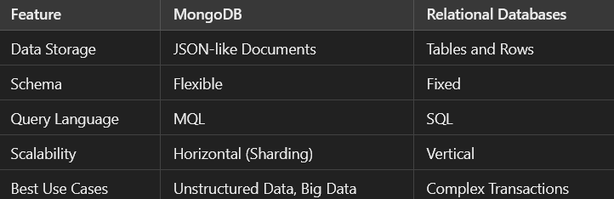
Key Differences Between MongoDB and Relational Databases

Slide 5
Core Operations in MongoDB (Mongoose)
Create: db.collectionName.insertOne({ name: "Alice", age: 25 });
Find: db.collectionName.find({ age: { $gt: 20 } });
Update: db.collectionName.updateOne({ name: "Alice" }, { $set: { age: 26 } });
Delete: db.collectionName.deleteOne({ name: "Alice" });

Slide 6
MongoDB CRUD Operations
Create: Use insertOne() or insertMany() methods to add documents to a collection.
Read: Use find() and findOne() methods to query documents from a collection.
Update: Use updateOne(), updateMany(), or replaceOne() methods to modify existing documents.
Delete: Use deleteOne() or deleteMany() to remove documents from a collection.

Slide 7

CRUD

Slide 8
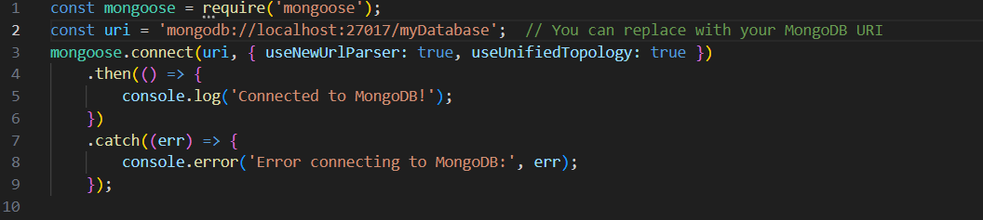
Connecting to MongoDB using Mongoose
useNewUrlParser: true: This option tells Mongoose to use the new URL parser for the connection string. MongoDB's connection string format evolved, and this option ensures Mongoose uses the newer parser, which avoids deprecation warnings.
useUnifiedTopology: true: This option tells Mongoose to use the new server discovery and monitoring engine. It's a more stable and future-proof way of handling connections, especially in distributed database setups.

Slide 9
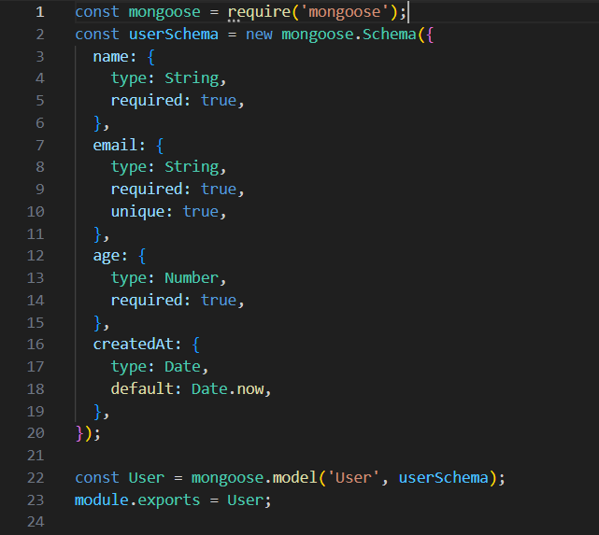
Define a Mongoose Model

Slide 10
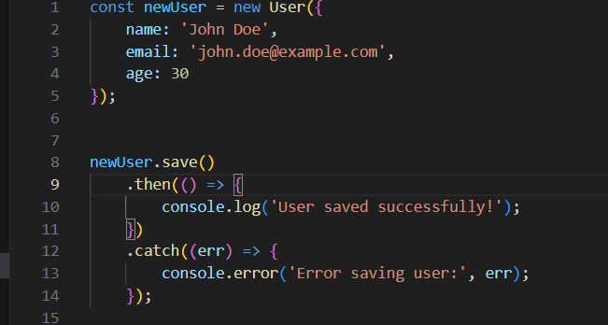
Create a New Document

Slide 11
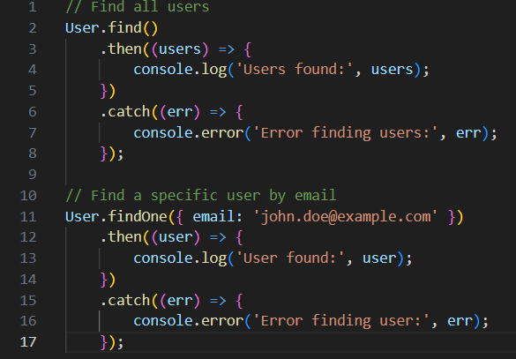
Find

Slide 12
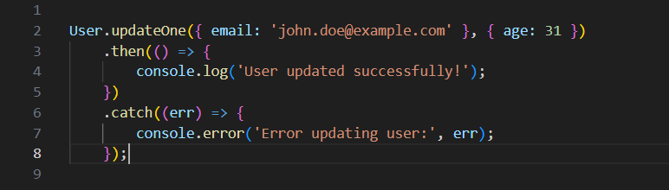
Update

Slide 13
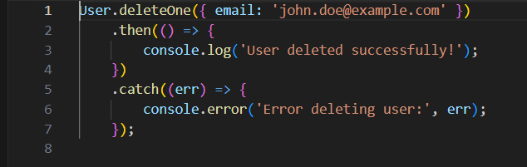
Delete

Slide 14
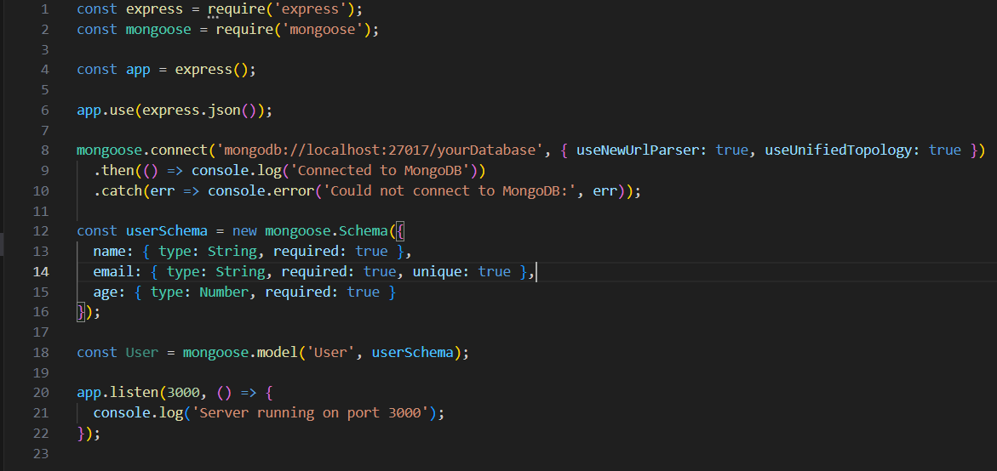
Using Express JS

Slide 15
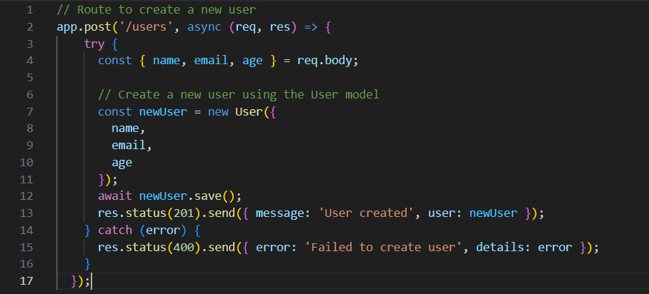
Create (POST)

Slide 16
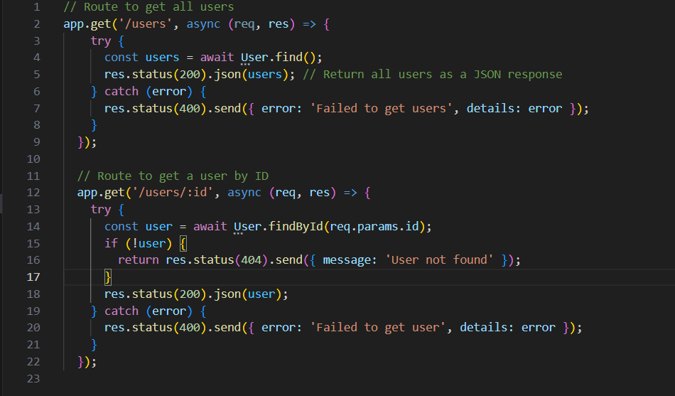
Read (GET)

Slide 17
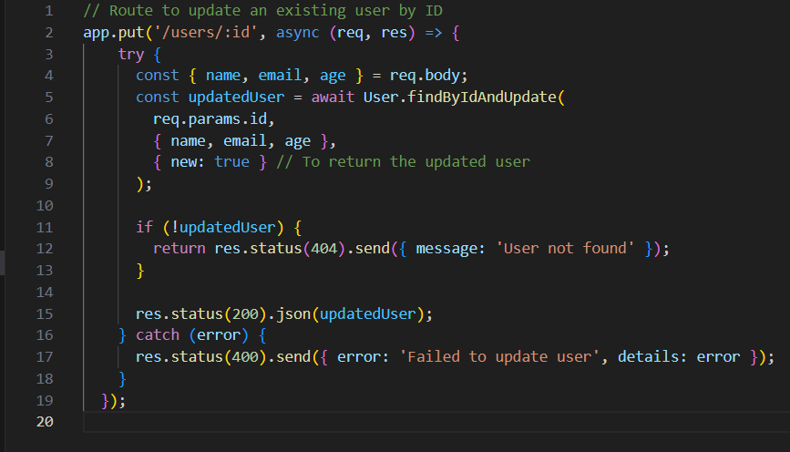
Update (PUT)

Slide 18
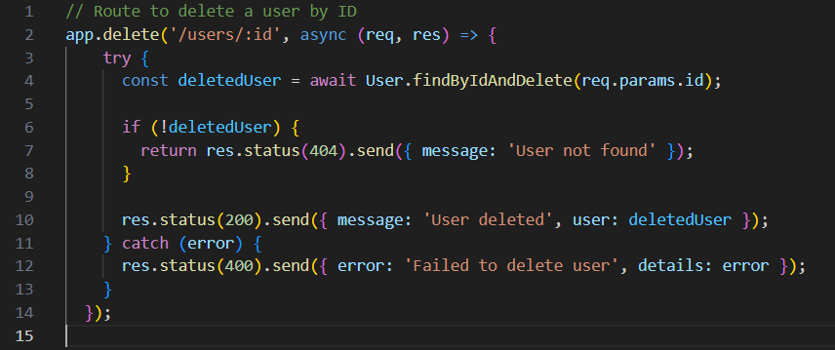
Delete (DELETE)

Slide 19
Thank You
Bobby B Wilfred (23BCE1828)
Number: 7358429420
Email: bobby.bwilfred2023@vitstudent.ac.in

